Slide 1

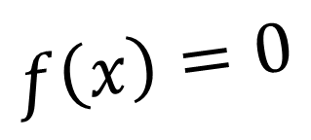
CH2120 The Secant Method
$$f\left(x\right)=0$$
Class 18
September 21, 2022

Slide 2

f(x) = 3x + sin(x) - e^{x}

Slide 3

The Secant Method
2
3
3
2
1
1

Slide 4
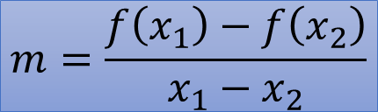
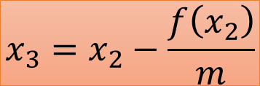
The Secant Method
$$m=\frac{f\left(x_{1}\right)−f\left(x_{2}\right)}{x_{1}−x_{2}}$$
$$x_{3}=x_{2}−\frac{f\left(x_{2}\right)}{m}$$
3
2
1

